Slide 1
Singapore’s Covid Cases
Marcus Li

Slide 2
AGENDA
Data Sets
Data Sets Exploration
Data Analysis

Slide 3
Data Sets
1. Data set used: Epidemic Curve: https://data.gov.sg/dataset/covid-19-case-numbers?resource_id=400a3eb4-8702-4050-9700-988bfea7a20f
2. Data set used: patients needing oxygen supplementation icu care or died by age groups: https://data.gov.sg/dataset/covid-19-case-numbers?resource_id=9de30d8d-3c0d-48ab-8c1b-4a7dc03d687a
3. Data set used: moving ave of deaths active cases in icu per 100k population by vaccination status: https://data.gov.sg/dataset/covid-19-case-numbers?resource_id=aa6ba85e-c256-4eef-99ca-7849c7d6f148

Slide 4
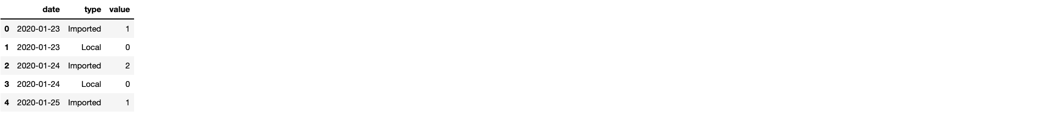
Data Sets Exploration
The data from Epidemic Curve is simple to understand as it only has the dates and how many people got covid on the date for Local and Imported.
The data goes from 2020 jan – 2023 feb

Slide 5
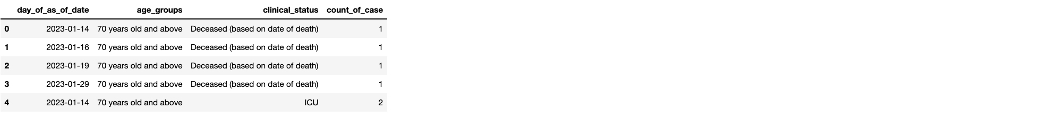
Data Sets Exploration
The data from patients needing oxygen supplementation icu care or died by age groups only goes from 14 Jan 2023 – 10 feb 2023, which is 1 months worth of data only

Slide 6
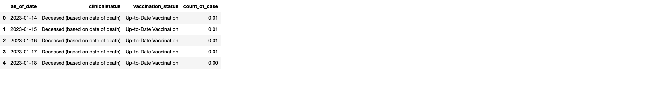
Data Sets Exploration
The data from moving ave of deaths active cases in icu per 100k population by vaccination status shows normalized date of clinical status of patients in ICU based on their vaccination status.
The data too is also 1 month from 14 Jan 2023 – 10 feb 2023

Slide 7
Are they downplaying covid on the news???

Slide 8
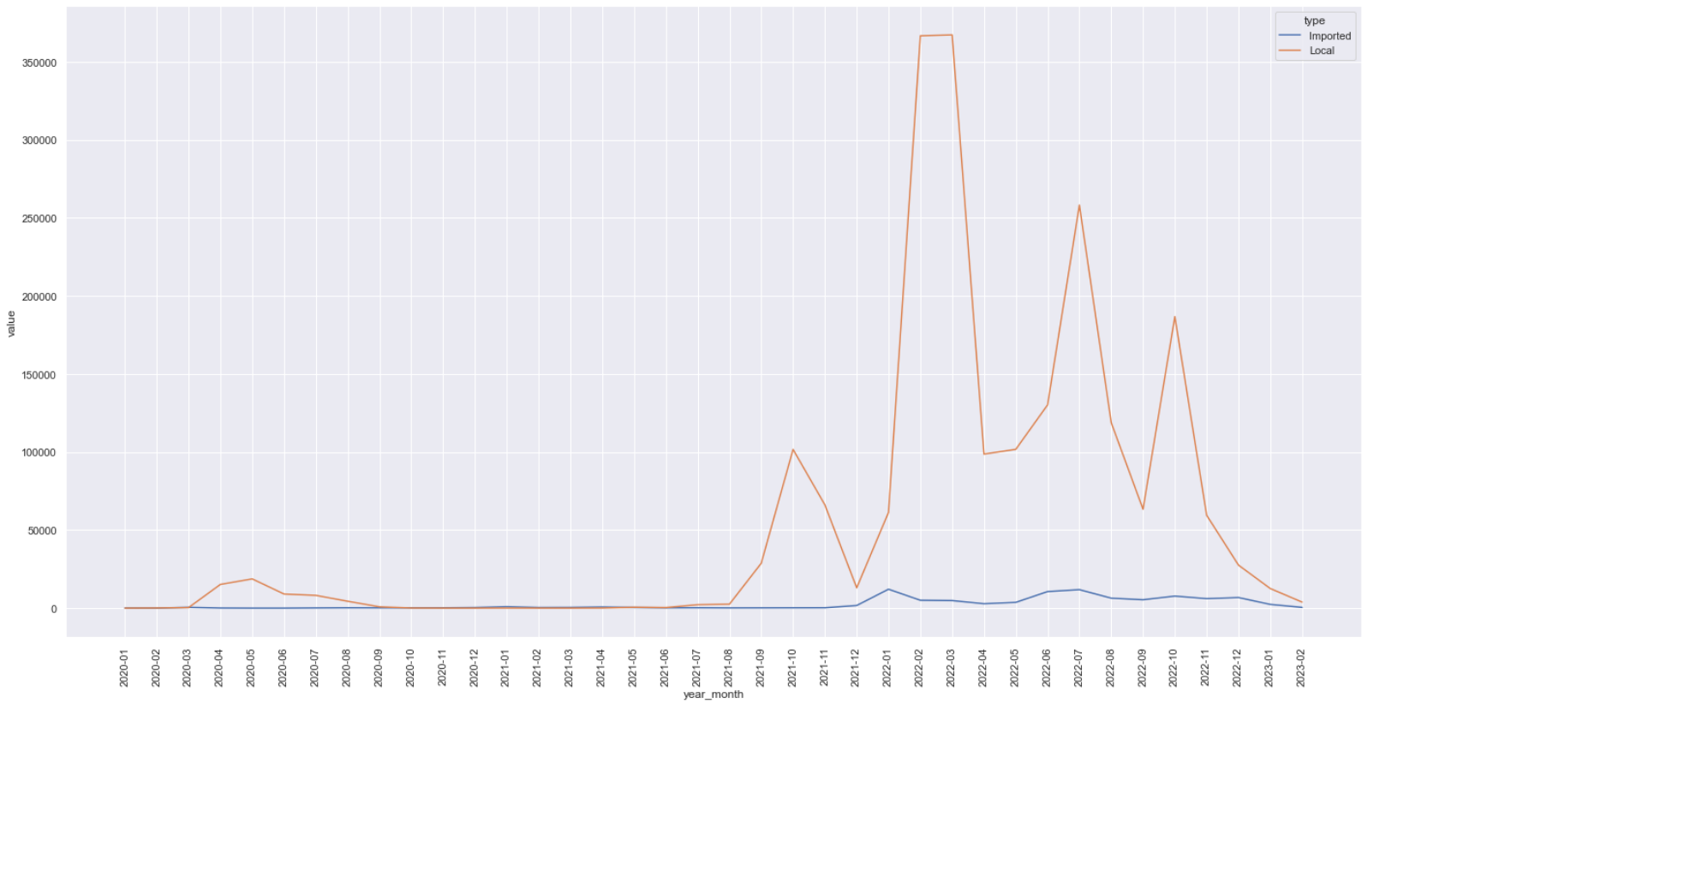
Are the locals getting covid from imported cases?
Looks to be very little correlation at first glance.
Imported cases is always much lower than local cases.
Data set used: Epidemic Curve: https://data.gov.sg/dataset/covid-19-case-numbers?resource_id=400a3eb4-8702-4050-9700-988bfea7a20f
Singapore’s Covid Cases

Slide 9
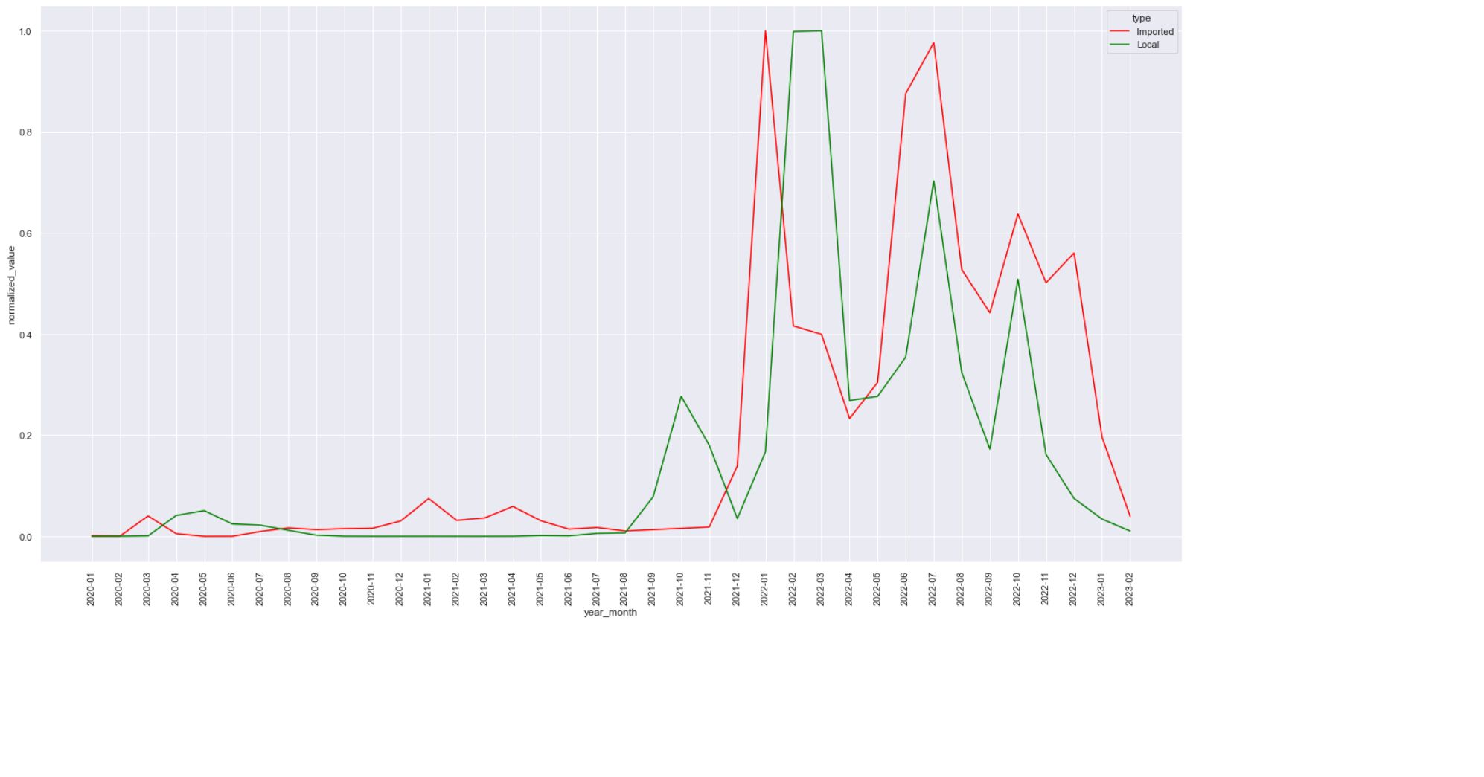
Are the locals getting covid from imported cases normalised?
However when we normalize the data, we can see that imported cases always spike before local cases
However in June 2022 onwards we can see that local and imported spike together
Data set used: Epidemic Curve: https://data.gov.sg/dataset/covid-19-case-numbers?resource_id=400a3eb4-8702-4050-9700-988bfea7a20f
Singapore’s Covid Cases

Slide 10
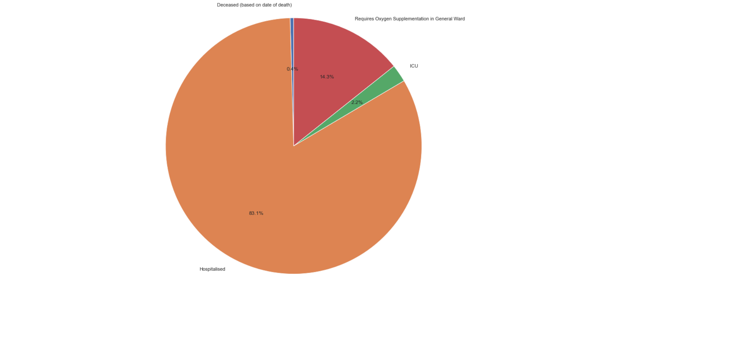
has covid situation become better
Clinical Status from Jan-Feb 2023
Deceased: 5
Hospitalised: 941
ICU: 25
Requires oxygen in general Ward: 162
However as the data source doesn’t tell whether the patients are new or existing, the numbers doesn’t mean much. But it does tell us that there are large amounts of people who are in the hospital and require oxygen vs deceased or in ICU
Data set used: Epidemic Curve: https://data.gov.sg/dataset/covid-19-case-numbers?resource_id=400a3eb4-8702-4050-9700-988bfea7a20f
Singapore’s Covid Cases

Slide 11
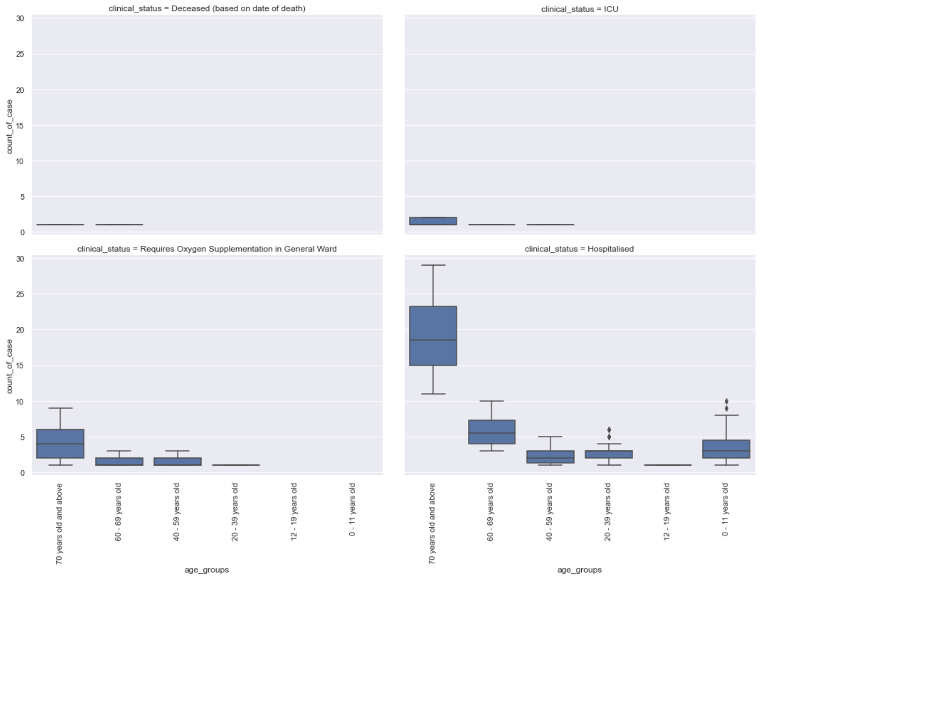
Covid status by age group
And most of the patients are made up of 70 years old and up.
What I am surprised to see 0-11 year olds hospitalized from covid with a higher median than ages 12 – 59
Data set used: patients needing oxygen supplementation icu care or died by age groups: https://data.gov.sg/dataset/covid-19-case-numbers?resource_id=9de30d8d-3c0d-48ab-8c1b-4a7dc03d687a
Singapore’s Covid Cases

Slide 12
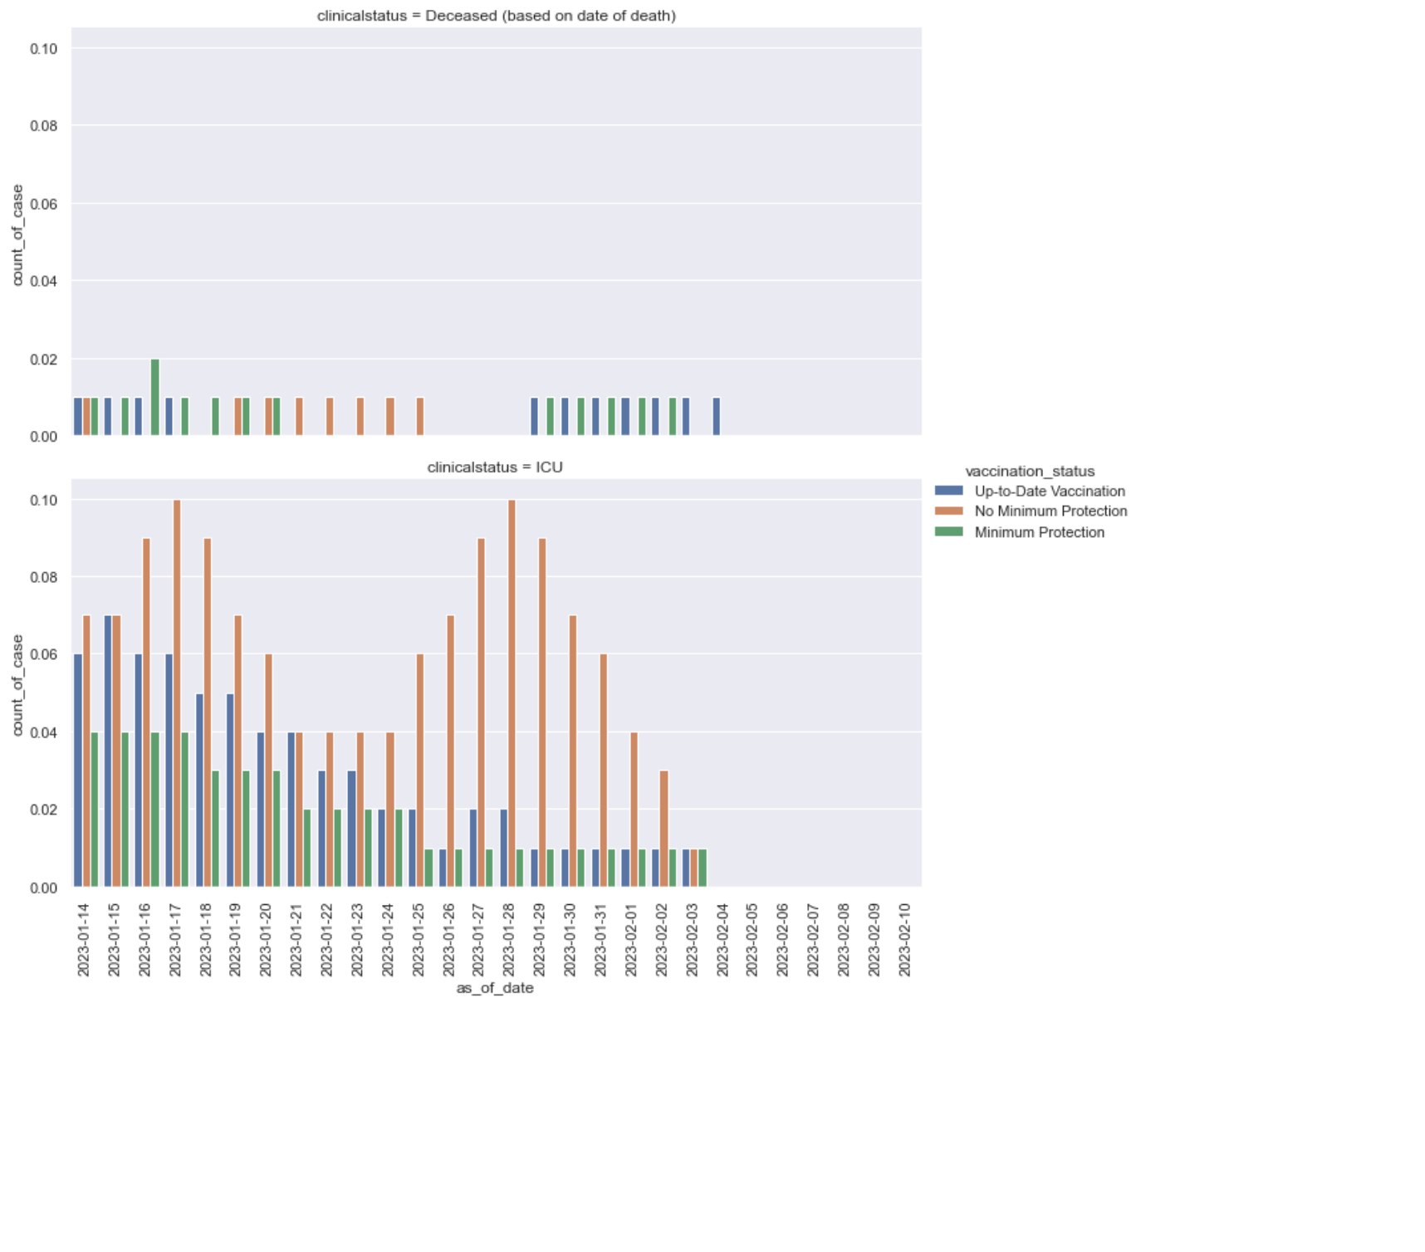
Clinical status by vaccination status
Death rates between all vaccination statuses are the same but it looks like minimum protection & up-to-date has more occurrences.
As for ICU, there are more cases of people from no minimum protection, followed by up to date vaccination and then minimum protection.
Data set used: moving ave of deaths active cases in icu per 100k population by vaccination status: https://data.gov.sg/dataset/covid-19-case-numbers?resource_id=aa6ba85e-c256-4eef-99ca-7849c7d6f148
Singapore’s Covid Cases

Slide 13
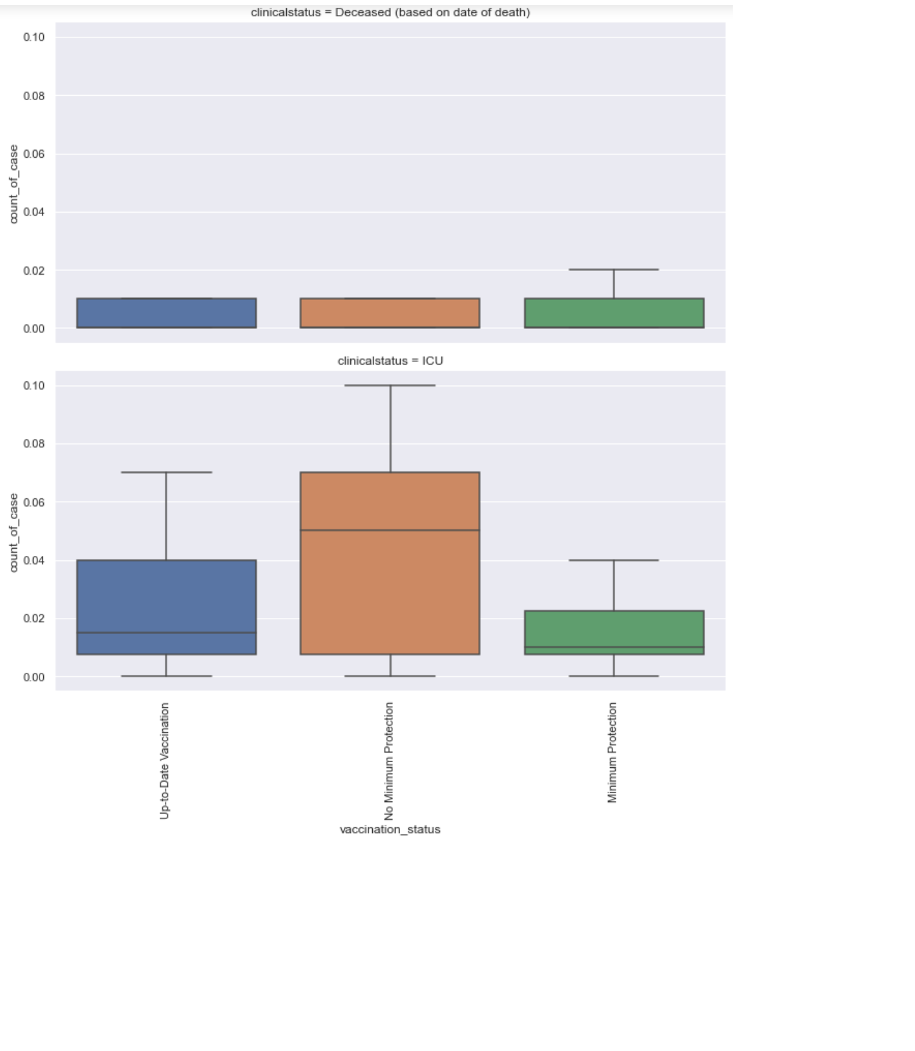
Clinical status by vaccination status
Using a box plot, the median of no minimum protection are found in ICU is higher than the other vaccination statuses. With up-to-date vaccinations coming 2nd place.
Data set used: moving ave of deaths active cases in icu per 100k population by vaccination status: https://data.gov.sg/dataset/covid-19-case-numbers?resource_id=aa6ba85e-c256-4eef-99ca-7849c7d6f148
Singapore’s Covid Cases

Slide 14
In conclusion
It did look like the imported cases was spiking up the local cases in the first 2 years, but not in the later years
It does look like covid is causing a lot of people to be hospitalized but data is not full for anything to be concluded
It does seem that non vaccinated people are more likely to be in the ICU. Up-to-date vaccinated are second more likely to be in the ICU. However this is only from a month’s worth of data.
More detailed and historic data is needed!
Singapore’s Covid Cases

Slide 15
THANK YOU
Marcus Li
P7474801

